Slide 1
3 main challenges
Noise reduction
Memory
Customer-identification

Slide 2
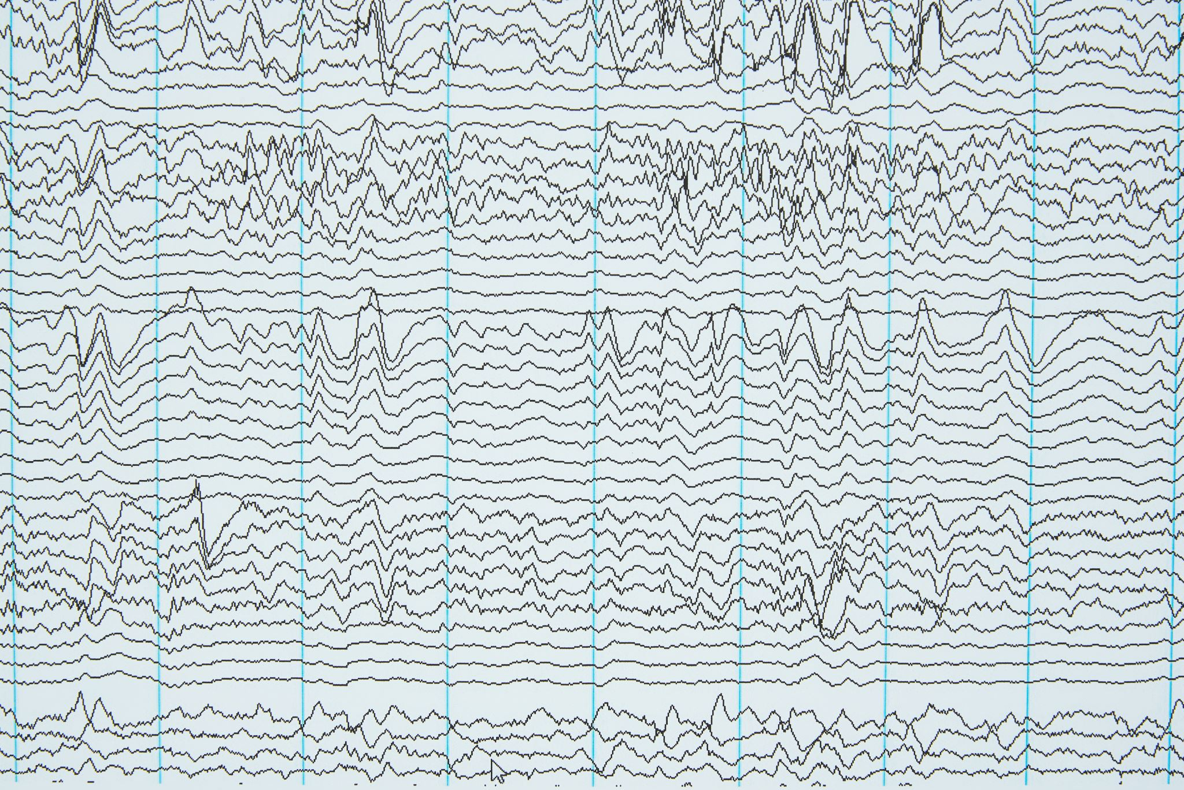
Noise Reduction
1. Other Voices → Volume:
Estimate the distance to a person based on volume
The closest person is identified as the current speaker
2. Background Noises → Frequency:
Focus only on the frequency range typical for human voices

Slide 3

Memory
We are storing the context of the conversation in form of text.
The last session (dialog text) is summarized by ChatGPT together with the memory if it exists.
Why this approach provides is good?
Memory-efficient storage
Latest data are more detailed

Slide 4

Distinguishing between the customers
New customer:
The identifying of the customer is done through vector-embedding
The vector assigned to the customer will be updated with every new session with this customer
Known customer:
Cosine-similarity: searching for the most similar vector (ID) in the memory
Voice (audio data)
Feature extraction
Vector

Slide 5
Extra Facilities
Memory Encryption
Logging
Privacy dashboards for users to view/delete their data
Automatic database backup with retention policies
Environmental impact metrics

